Slide 1
Project 3 SEAS 8515 for Dr. Adewale Akinfaderin by Michael Wacey

Slide 2
Plan
Project 3A
I have been using the Department of Education College Scorecard data
Develop a model to predict future earnings based on college characteristics like admission rate, attendance cost, professor status, and professor pay.
Project 3B
Execute it as specified
I will need to make some adjustments since the data provided is not the same as the example in class

Slide 3
Documentation – Project 3A
It took me considerable effort just to settle on the features that I would be using. The data set has many features and they are not easy to understand if you are not accustomed to the area.
Once I had the variables selected, I had numerous issues with Spark, Python, etc.
The instance in data bricks would shut down after about ten minutes of non use – I reached out to them and it seems to have been fixed.
The variables from the data set have spaces and special characters. For the most part they worked. But some programs gave unexpected errors. I eventually renamed them.

Slide 4
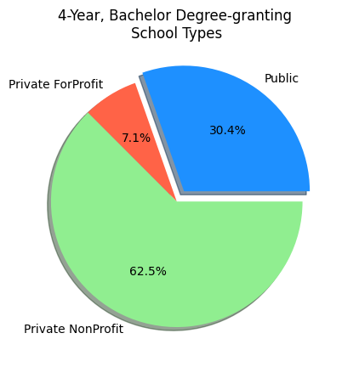
Report – Project 3A
Most of the data was for private non profit institutions.
I limited the set to institutions that primarily grant four year degrees.

Slide 5
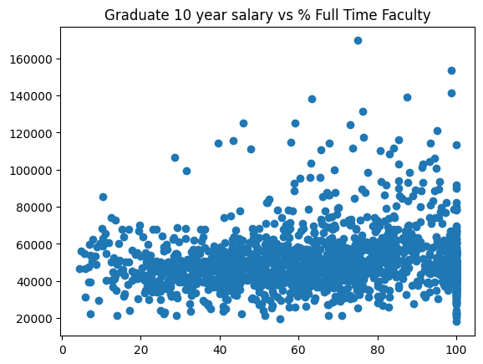
Professors impact on 10 Year out Salary
This graph shows the relationship between the percent of professors that are full time and the graduate salaries.
These salaries are ten years after the student started.
They are collected from IRS data.
Note that percent full time is reported by the institutions.

Slide 6
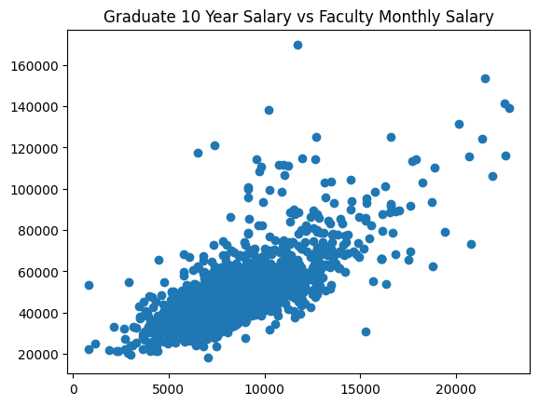
Professors Salaries
Here we can see that professors salaries do have an impact on graduate salaries.
There is a positive correlation between them.

Slide 7
Report – Project 3A
I used a linear regression to predict the salary of graduates after ten years. The features I used for the prediction were:
Admission Rate (%)
Attendance Cost per Academic Year
Full-time Faculty Rate (%)
Faculty's average salary per month
The result for the training data was:
8,605.36 for a mean of 50,766.17
R² of 0.64
These features do not seem to be predictive enough.
It would be worth looking at alternate features and models to get a better prediction.

Slide 8
Project 3B
I was able to learn a lot doing project 3 B but I would not say that it was successful.
Taking the examples from class and applying it to the Beats Dataset took some thinking
The class variable was text but needed to be indexed and then used as the Label – it took me several iterations to get this right
Performing correlations never worked for me. I could have done it for any two columns. But given that the features did not mean anything to me, I really wanted to run it against every combination of columns.
Just displaying the summary statistics for each feature took some effort.
I converted the Decision Tree Regressor to a Decision Tree Classifier and added a Random Forest Classifier. The results were not useful.

Slide 9
Thank You

